Slide 1
Generative AI with Large Language Models - Week 1
LLM pre-training and scaling laws
Machine-learning models are just big statistical calculators and they work with numbers, not words.

Slide 2
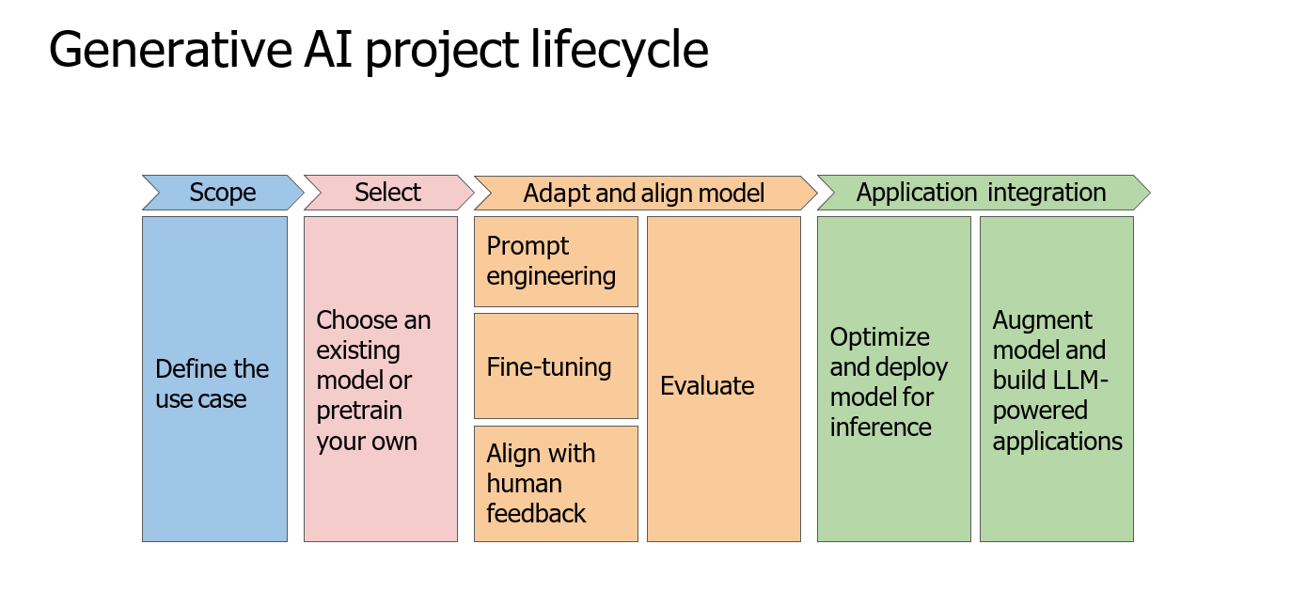

Slide 3
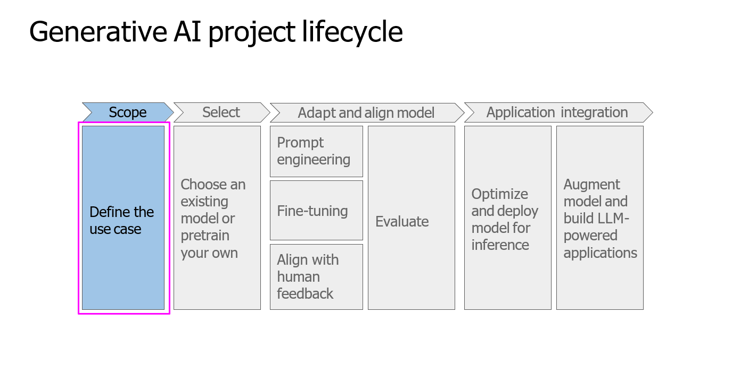
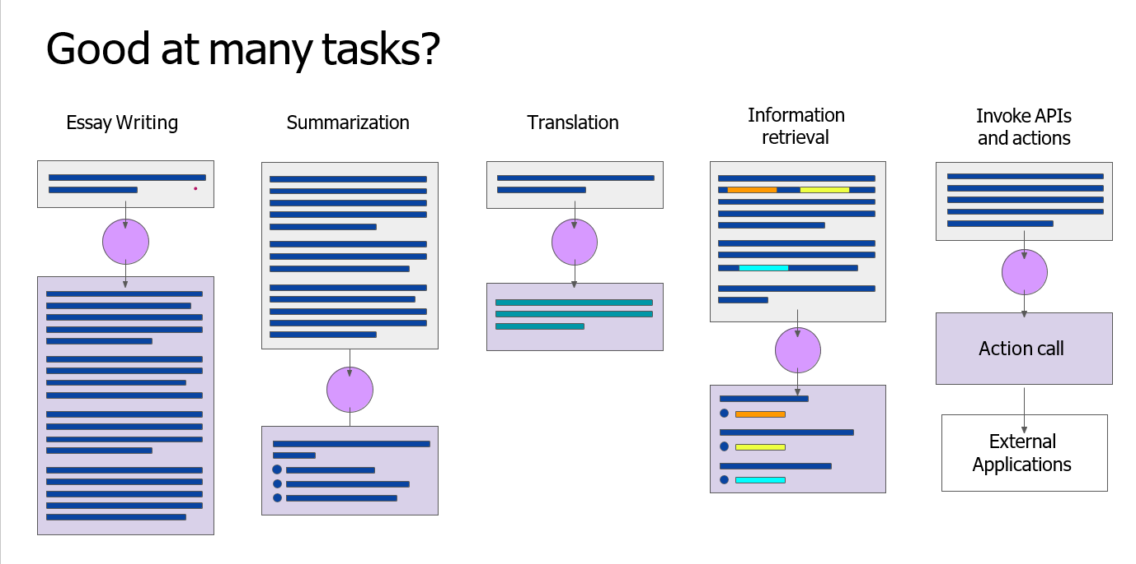
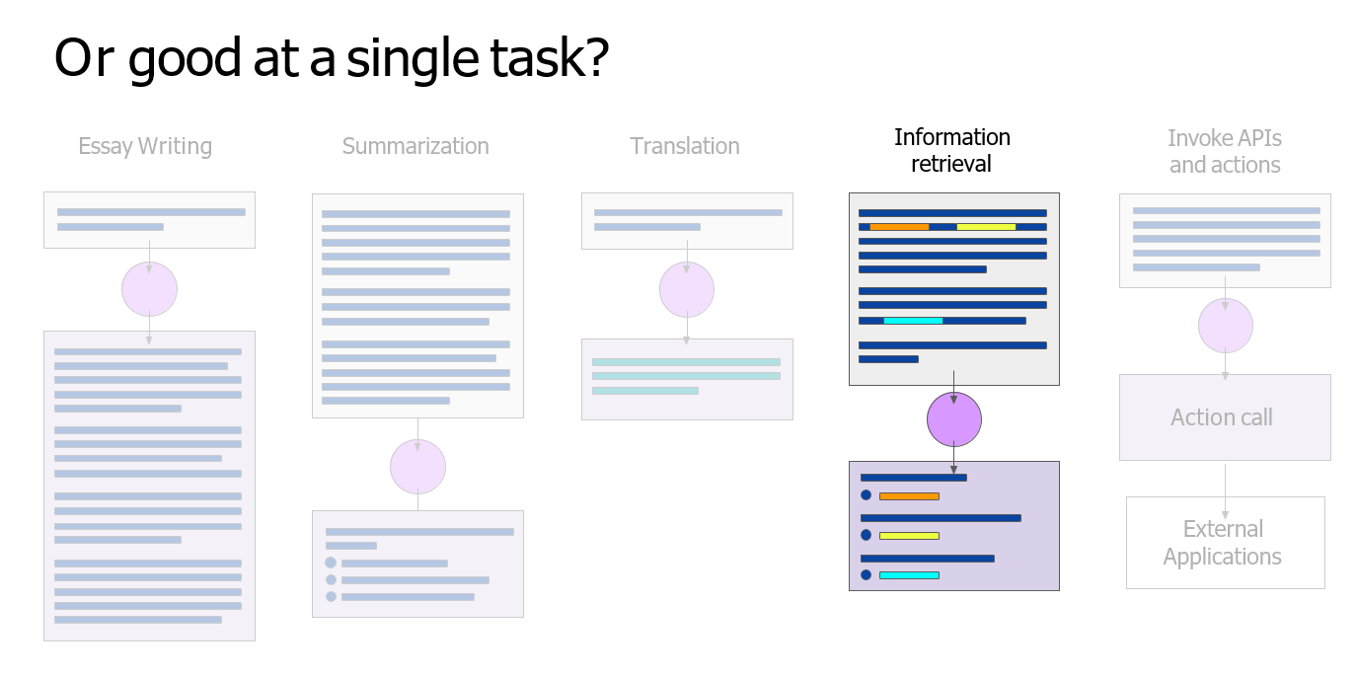

Slide 4
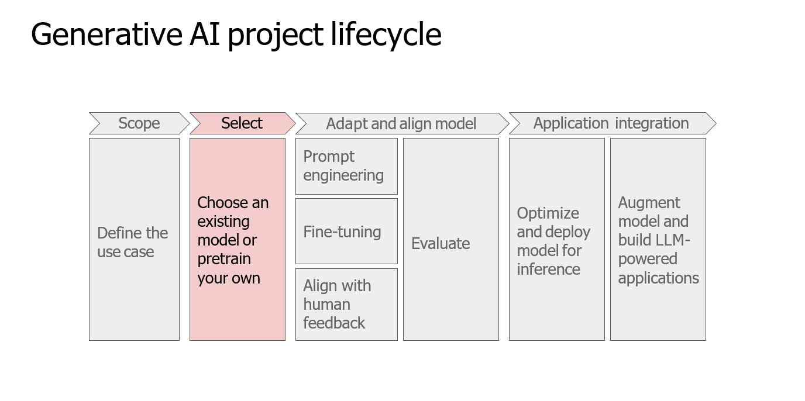
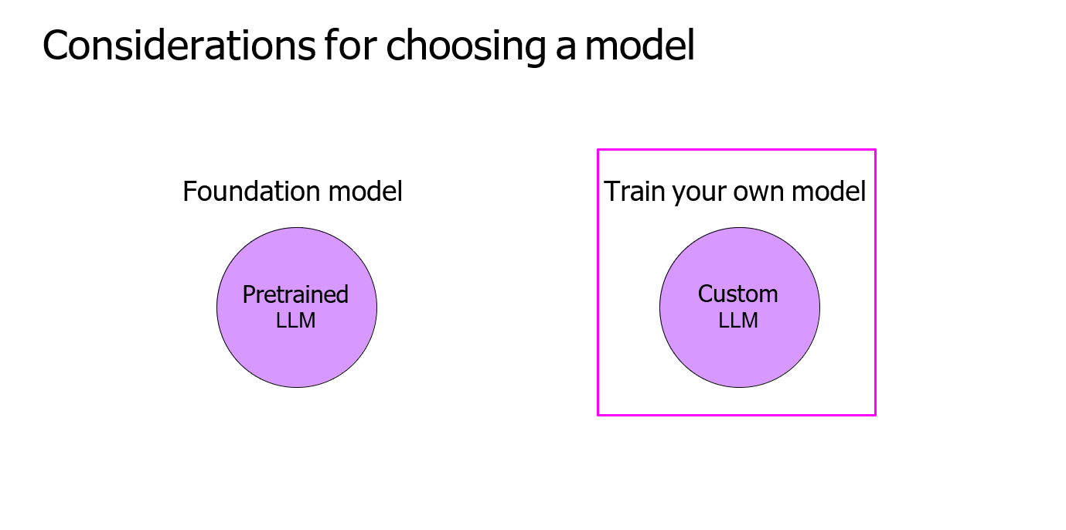
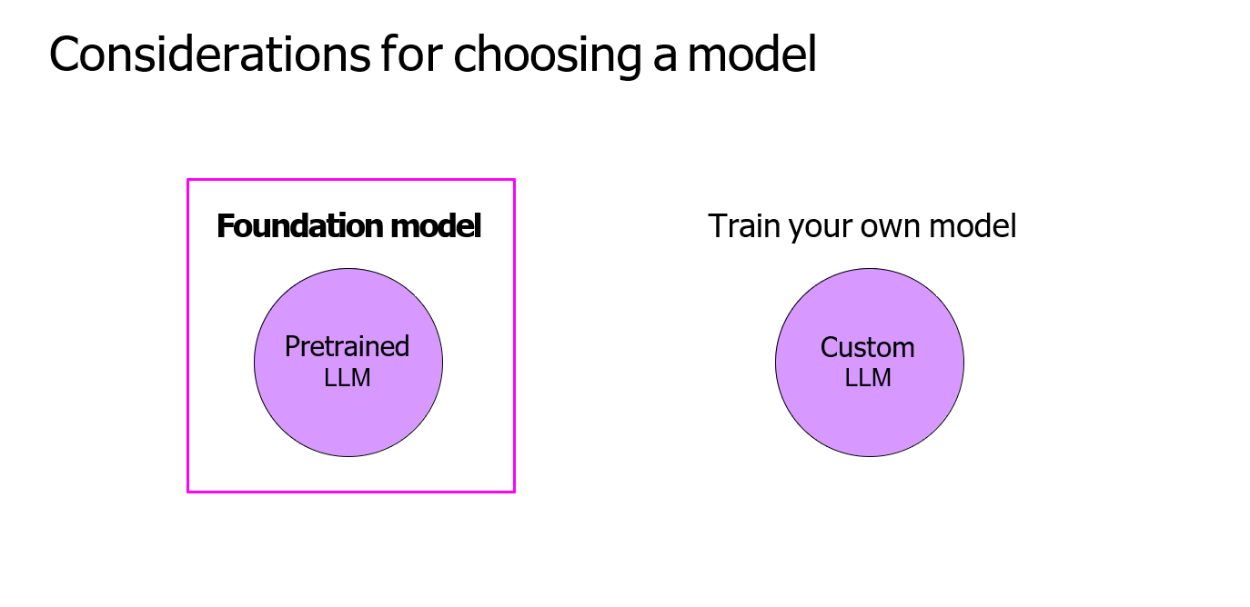

Slide 5
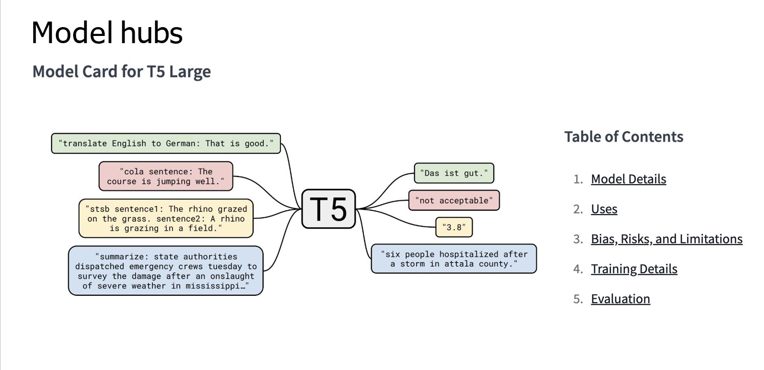
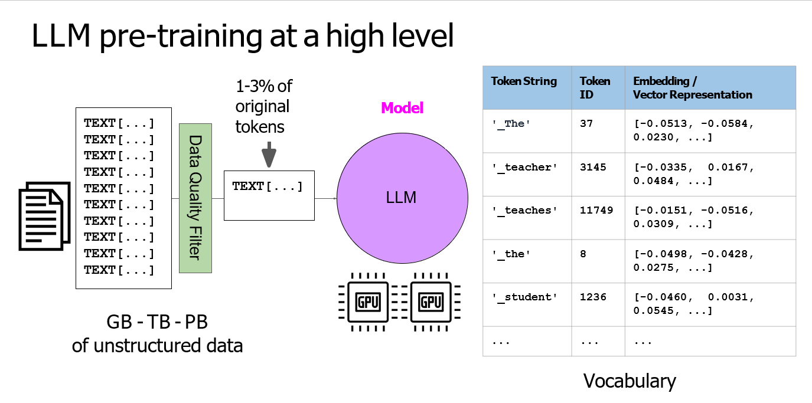
Many open-source models are available for members of the AI community like you to use in your application. The developers of some of the major frameworks for building generative AI applications like Hugging Face and PyTorch, have curated hubs where you can browse these models. A really useful feature of these hubs is the inclusion of model cards, that describe important details including the best use cases for each model, how it was trained, and known limitations.
the models pre-training phase when the model learns from vast amounts of unstructured textual data. This can be gigabytes, terabytes, and even petabytes of text. This data is pulled from many sources, including scrapes off the Internet and corpora of texts that have been assembled specifically for training language models. In this self-supervised learning step, the model internalizes the patterns and structures present in the language. These patterns then enable the model to complete its training objective, which depends on the architecture of the model During pre-training, the model weights get updated to minimize the loss of the training objective. The encoder generates an embedding or vector representation for each token. Pre-training also requires a large amount of compute and the use of GPUs. “when you scrape training data from public sites such as the Internet, you often need to process the data to increase quality, address bias, and remove other harmful content.” As a result of this data quality curation, often only 1-3% of tokens are used for pre-training. You should consider this when you estimate how much data you need to collect if you decide to pre-train your own model.

Slide 6
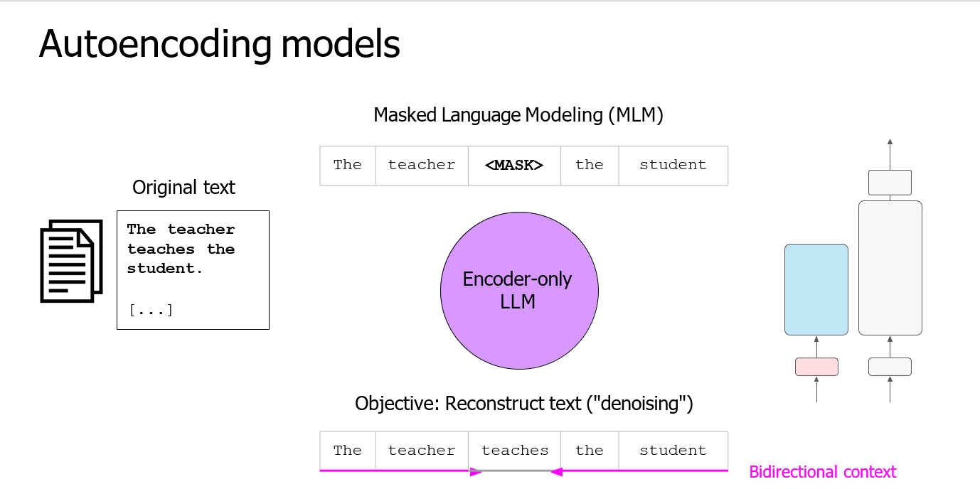
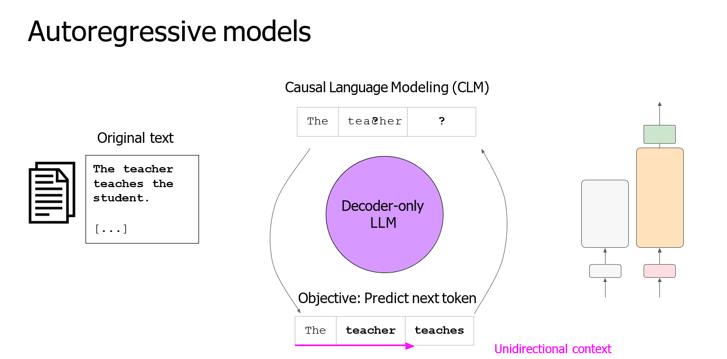
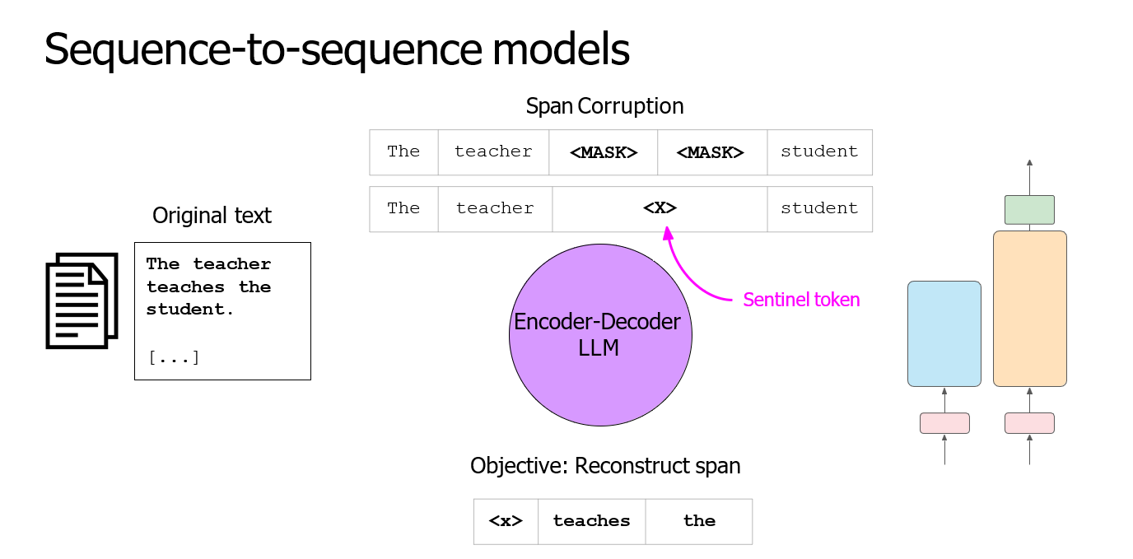
Encoder-only models are also known as Autoencoding models Good use cases:
Sentiment analysis, Named entity recognition, Word classification
Example models: BERT - Bidirectional Encoder Representations from Transformers
ROBERTA - A Robustly Optimized BERT Pretraining Approach
Decoder-only or autoregressive models, Good use cases: Text generation.
Example models: GPT - Generative Pre-trained Transformer
BLOOM - BigScience Large Open-science Open-access Multilingual Language Model
Sequence-to-sequence models use both the encoder and decoder part off the original transformer architecture.
Good use cases: Translation, Text summarization, Question answering
Example models: T5 - Text-to-Text Transfer Transformer
BART - Bidirectional and Auto-Regressive Transformers

Slide 7
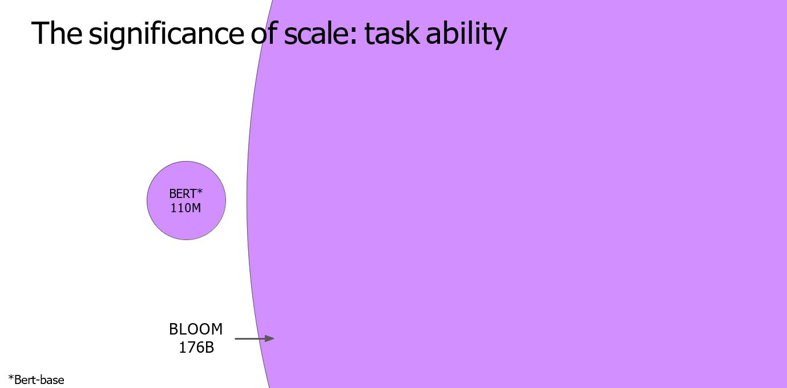
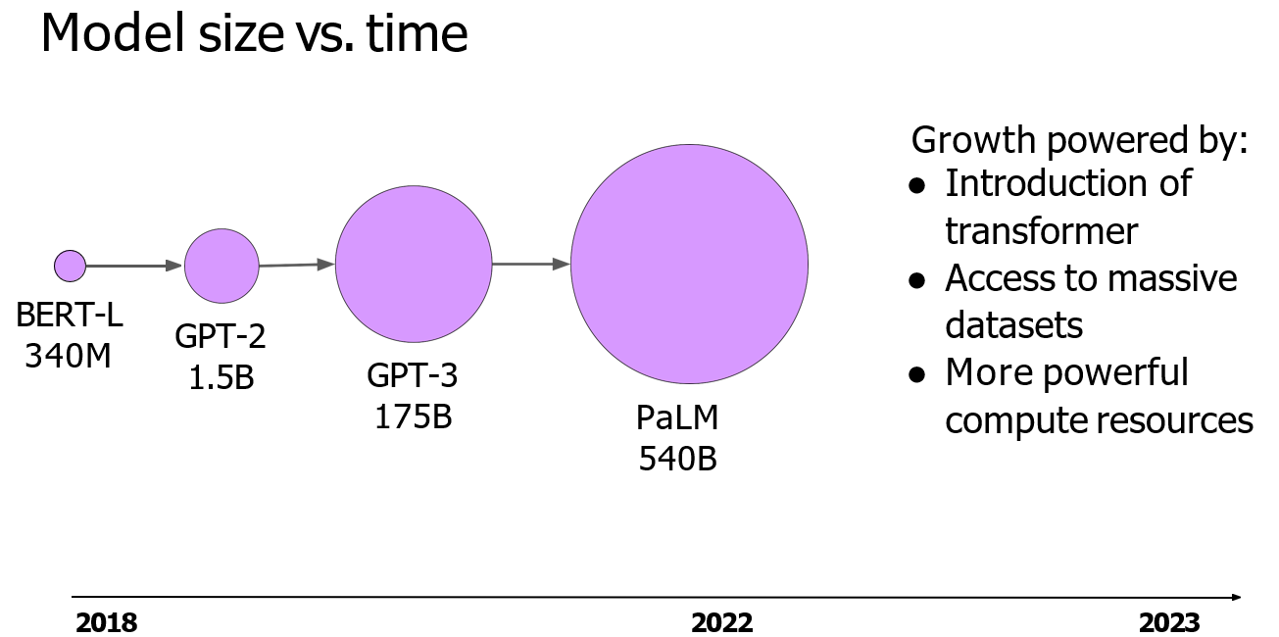
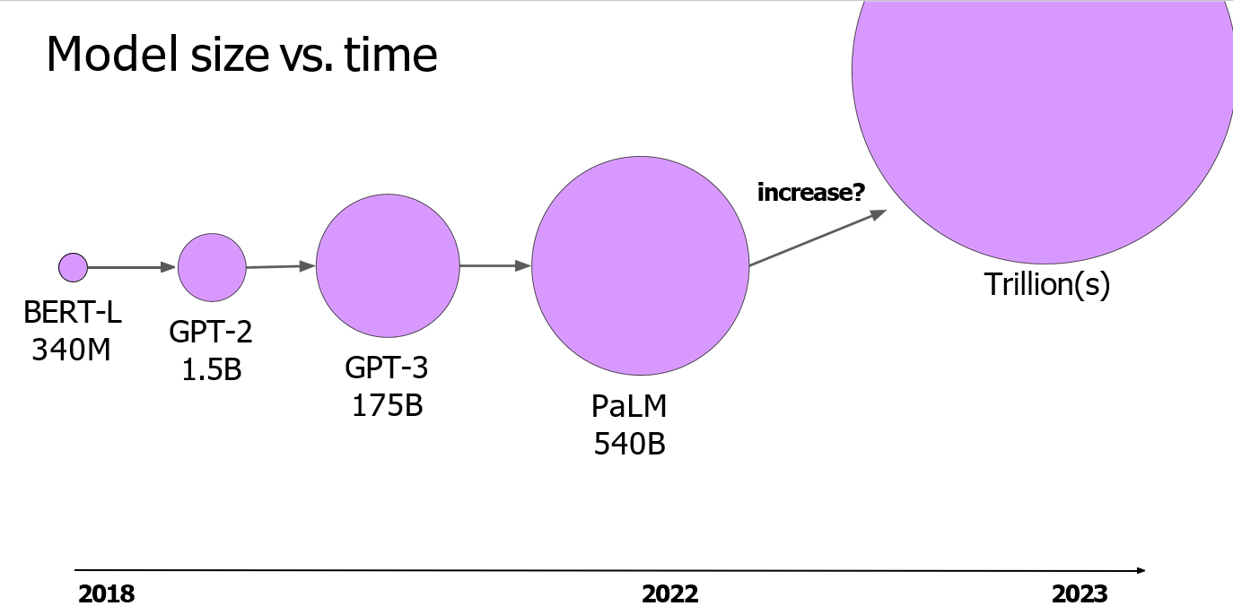
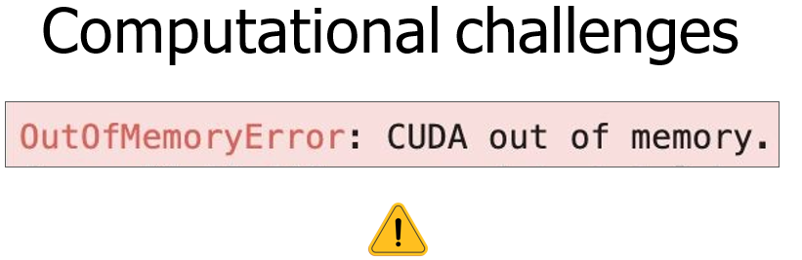
keep in mind is that larger models of any architecture are typically more capable of carrying out their tasks well. Researchers have found that the larger a model, the more likely it is to work as you needed to without additional in-context learning or further training. This observed trend of increased model capability with size has driven the development of larger and larger models in recent years. This growth has been fueled by inflection points and research, such as the introduction of the highly scalable transformer architecture, access to massive amounts of data for training, and the development of more powerful compute resources. This steady increase in model size actually led some researchers to hypothesize the existence of a new Moore's law for LLMs
CUDA, short for Compute Unified Device Architecture, is a collection of libraries and tools developed for Nvidia GPUs. Libraries such as PyTorch and TensorFlow use CUDA to boost performance on metrics multiplication and other operations common to deep learning.
NVIDIA A100 = 10 CPU, NVIDIA V100 = 5 CPU

Slide 8
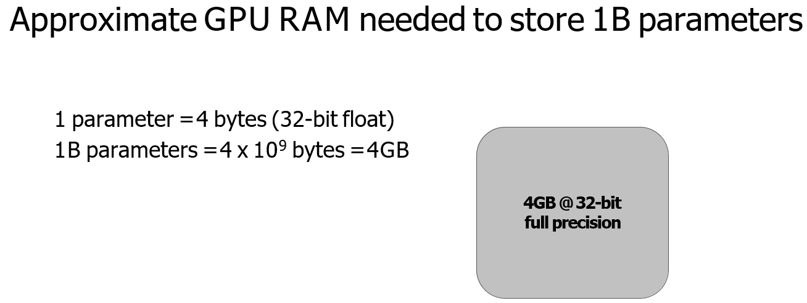
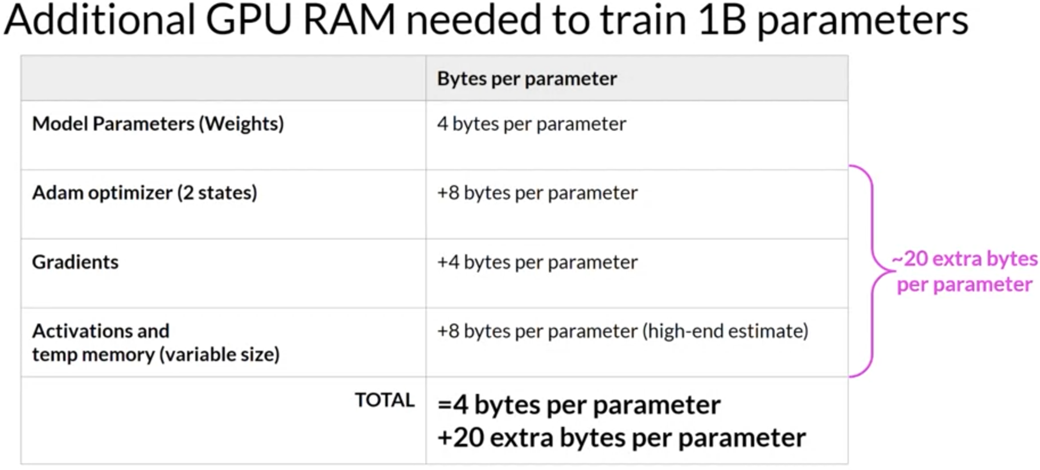
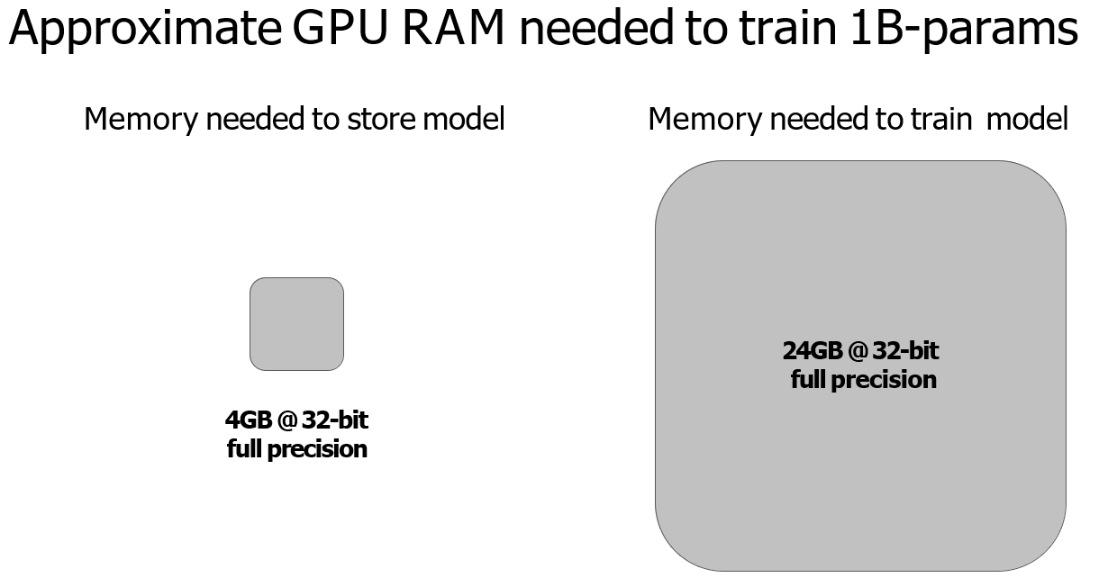
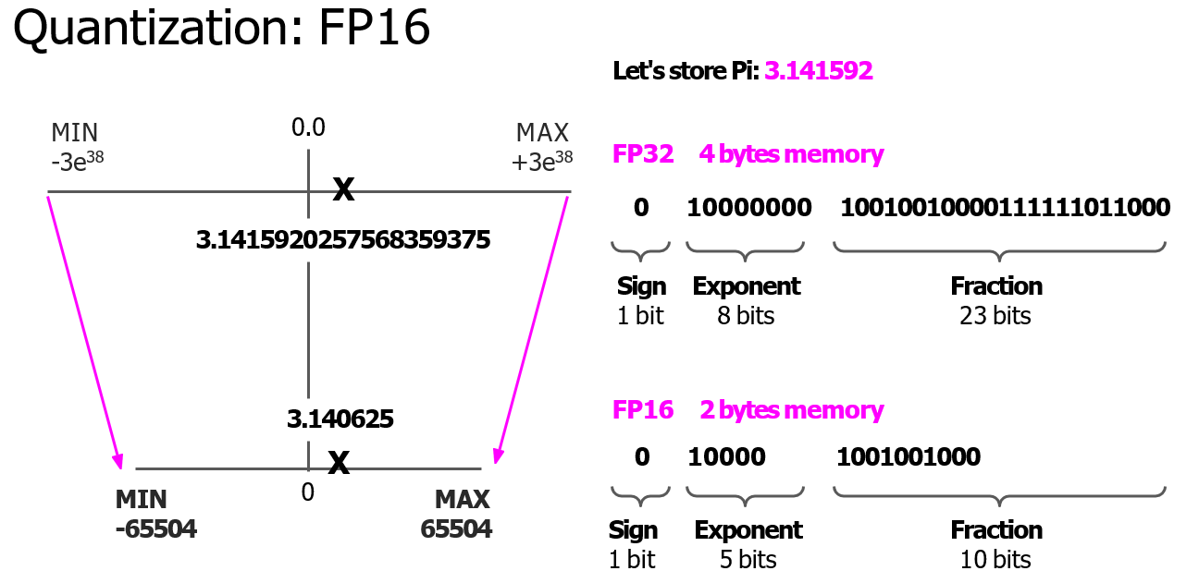
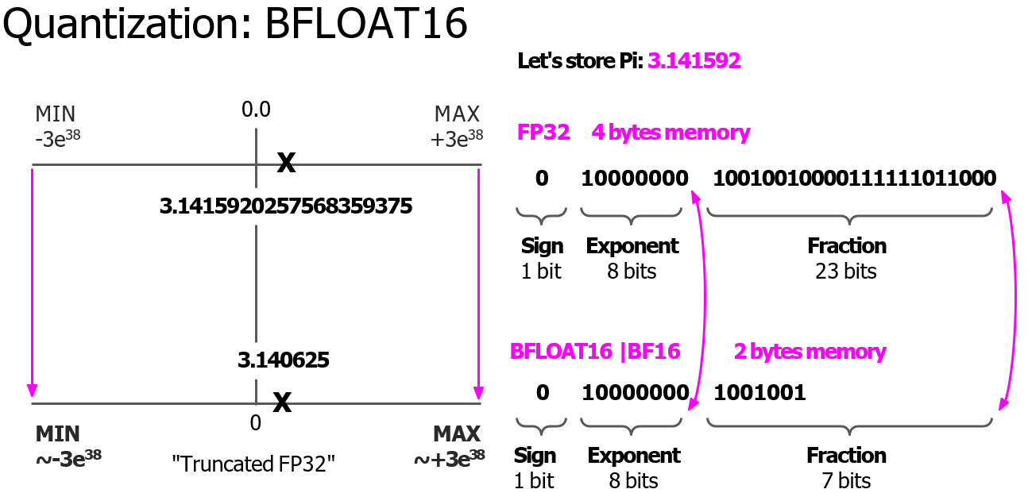
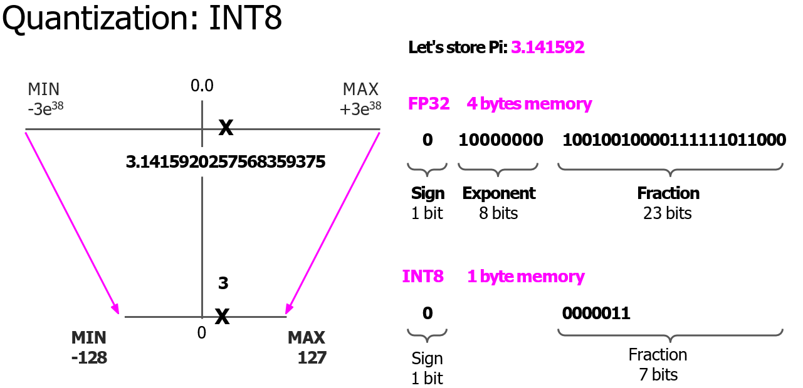
One technique that you can use to reduce the memory is called quantization. The main idea here is that you reduce the memory required to store the weights of your model by reducing their precision from 32-bit floating point numbers
to 16-bit floating point numbers, or eight-bit integer numbers.

Slide 9
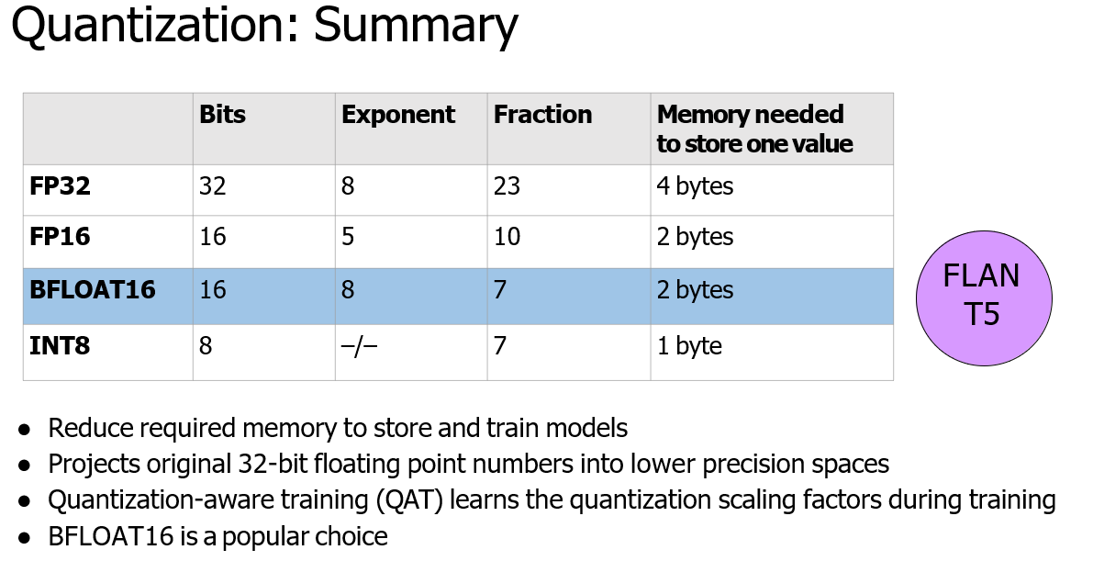
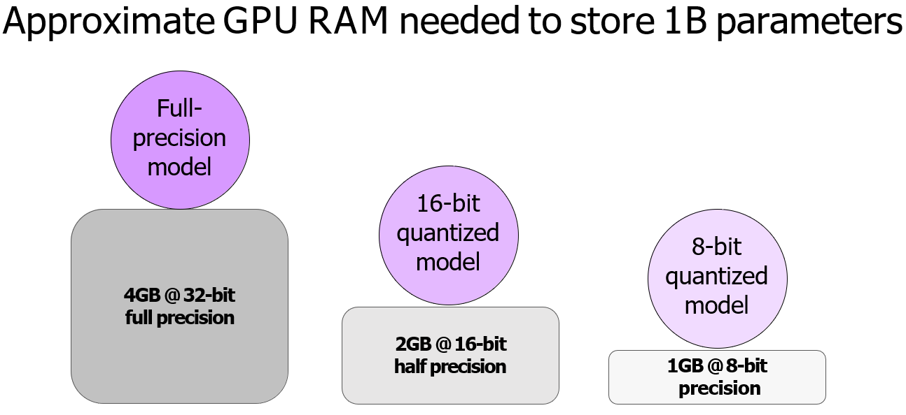
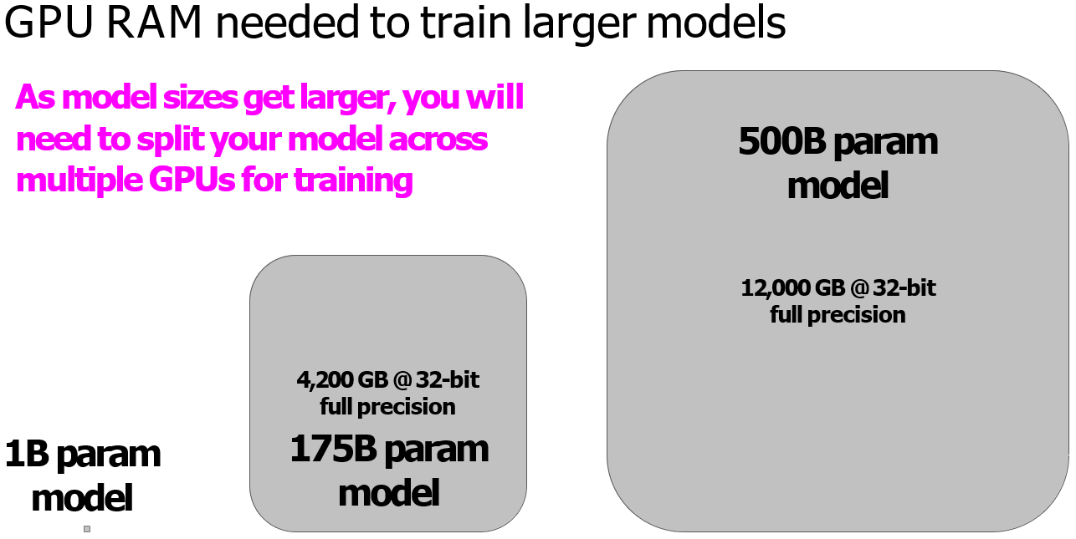
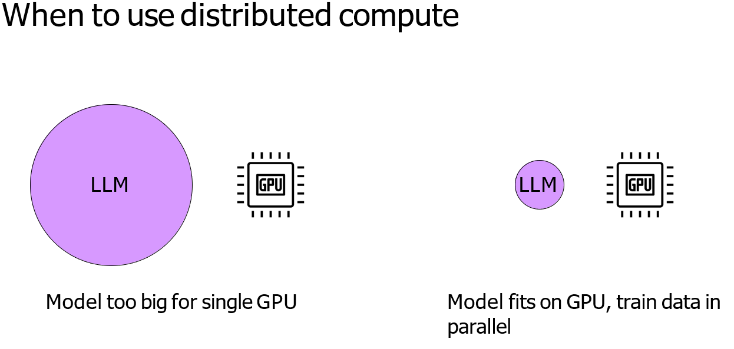

Slide 10
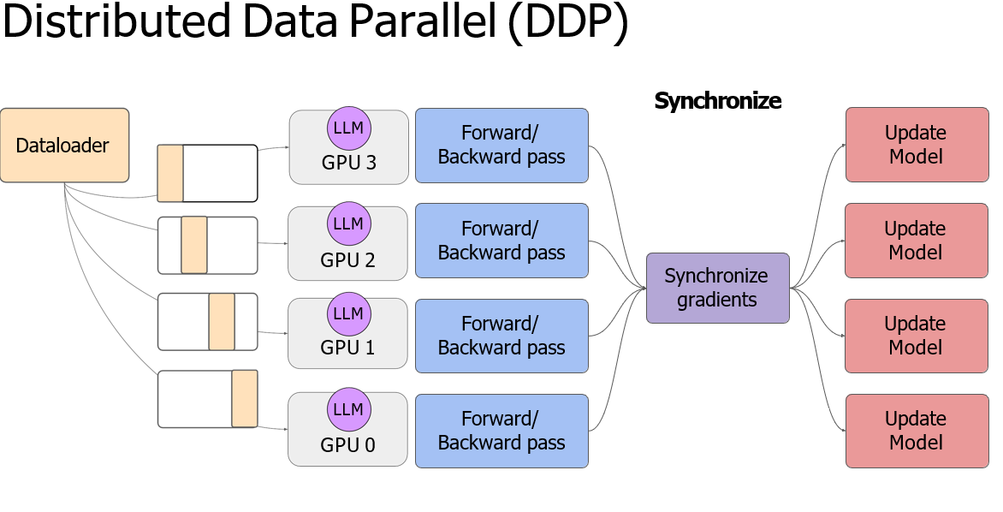
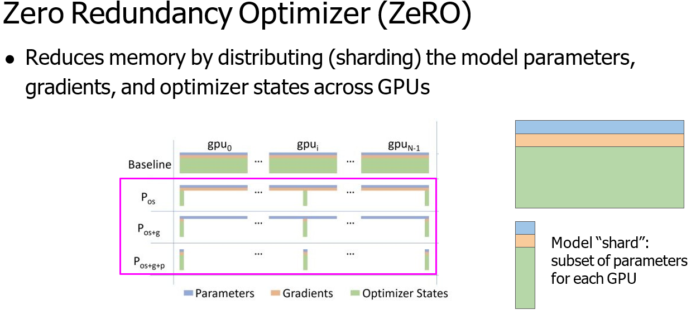
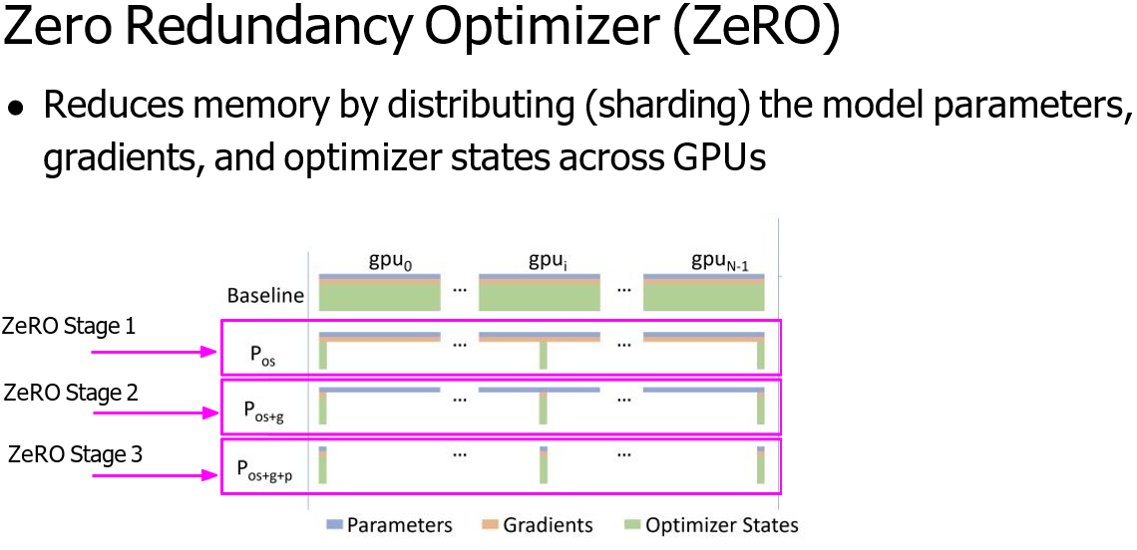
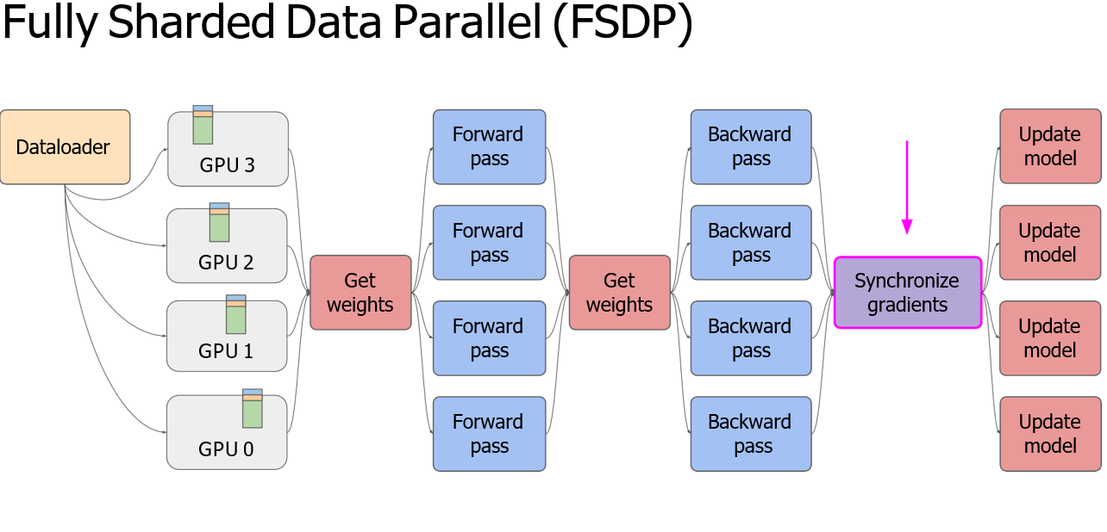

Slide 11
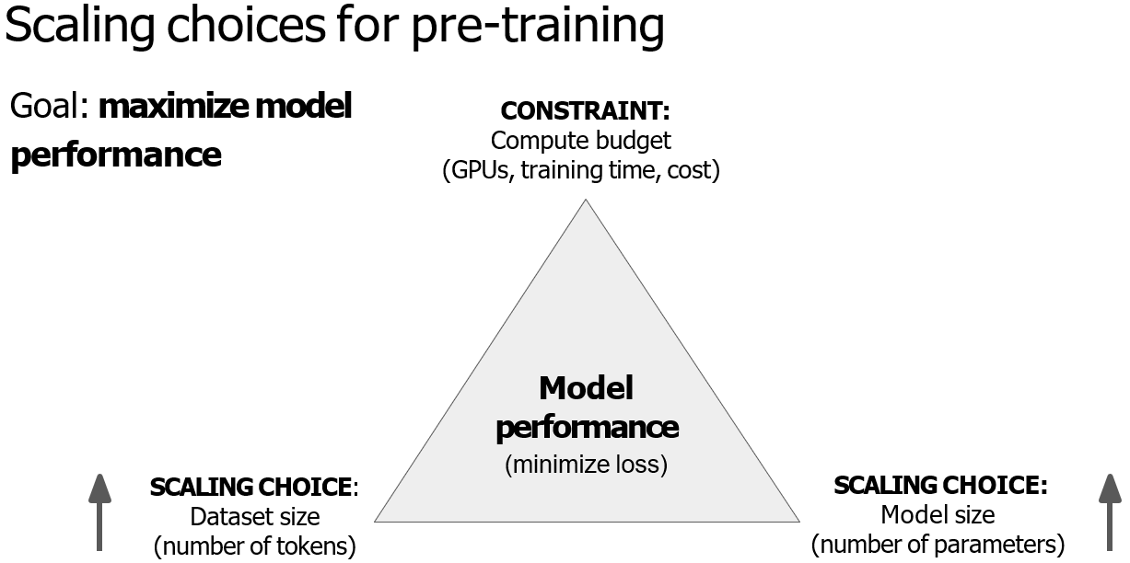
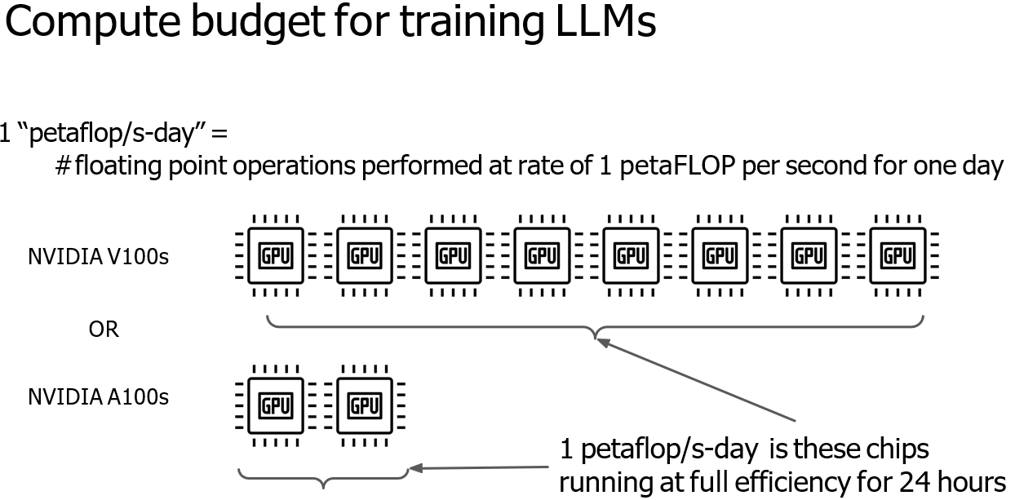

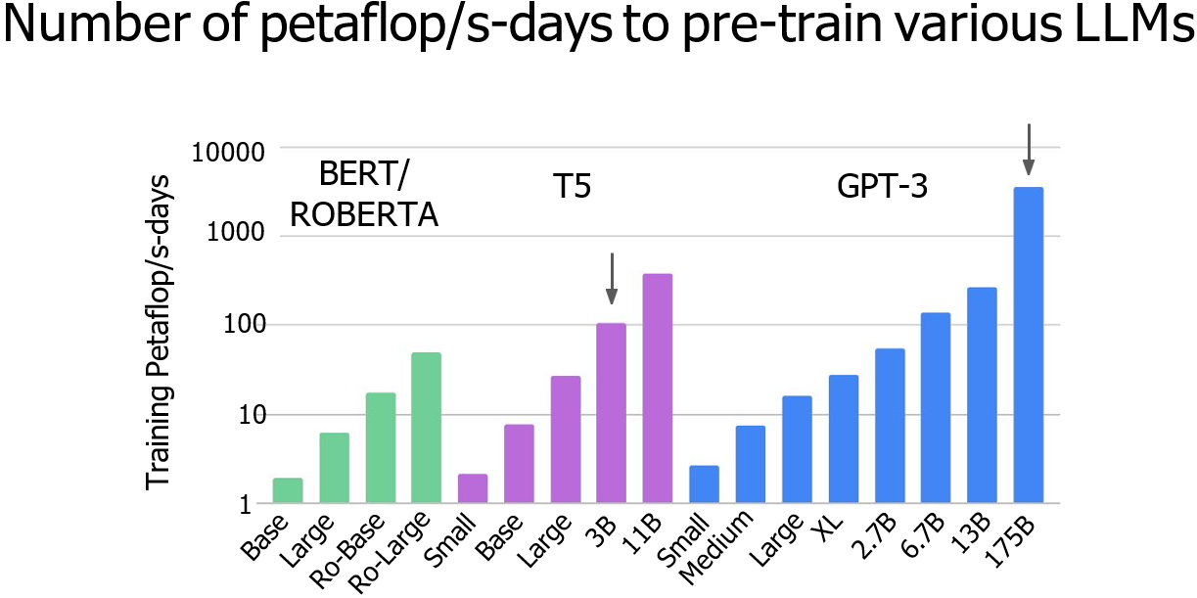
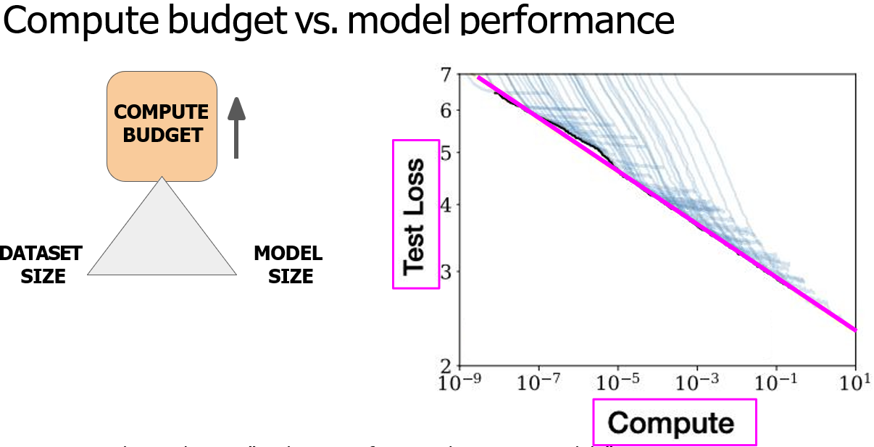

Slide 12
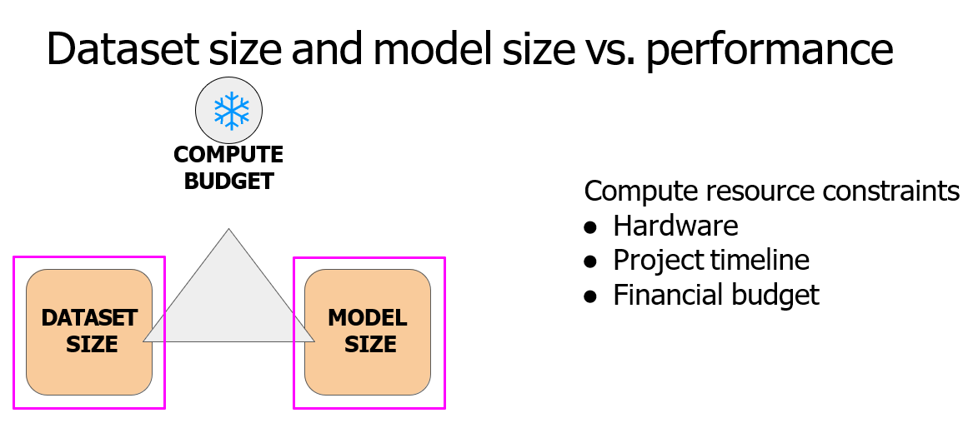
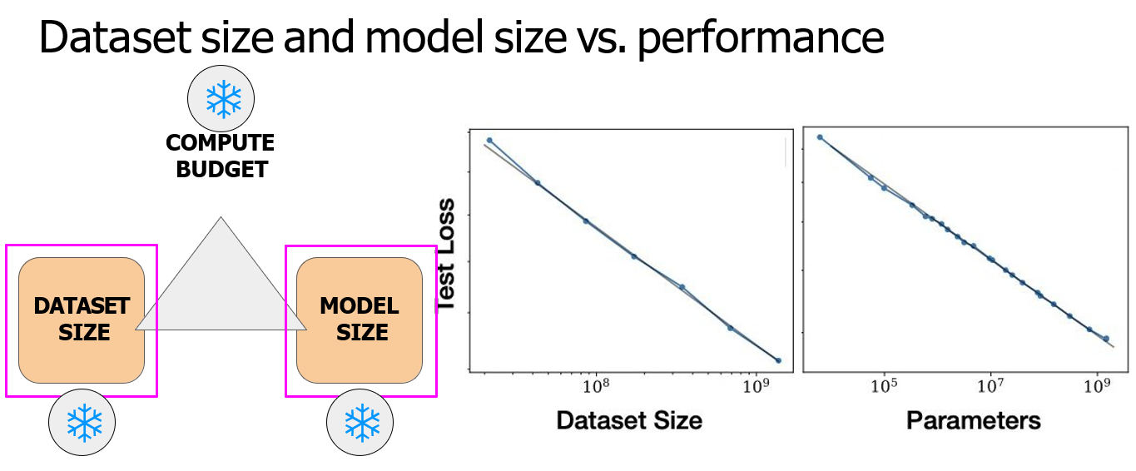
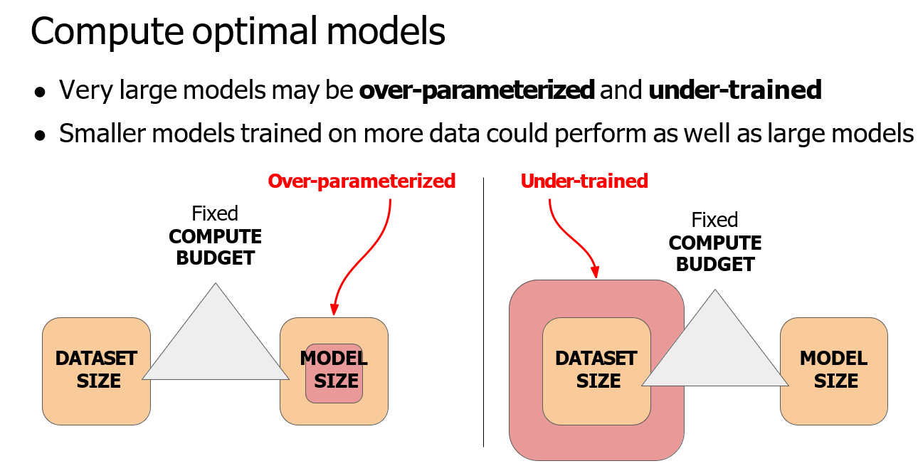
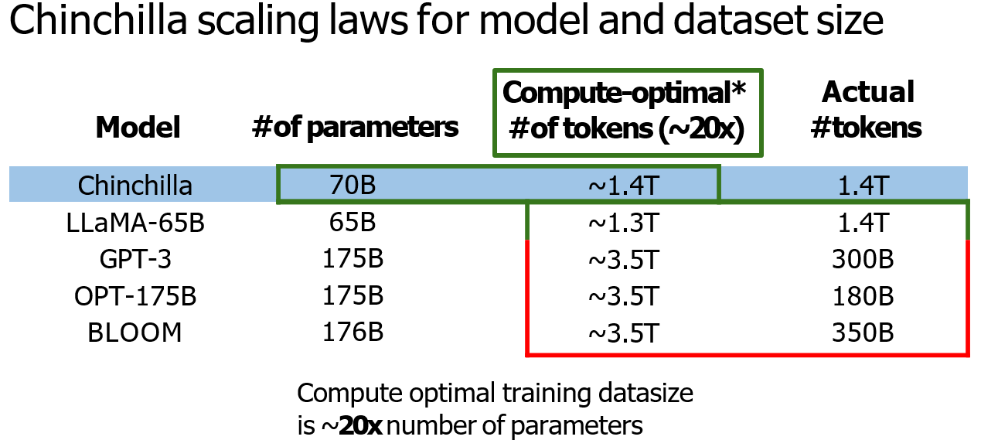

Slide 13
